Slide 1


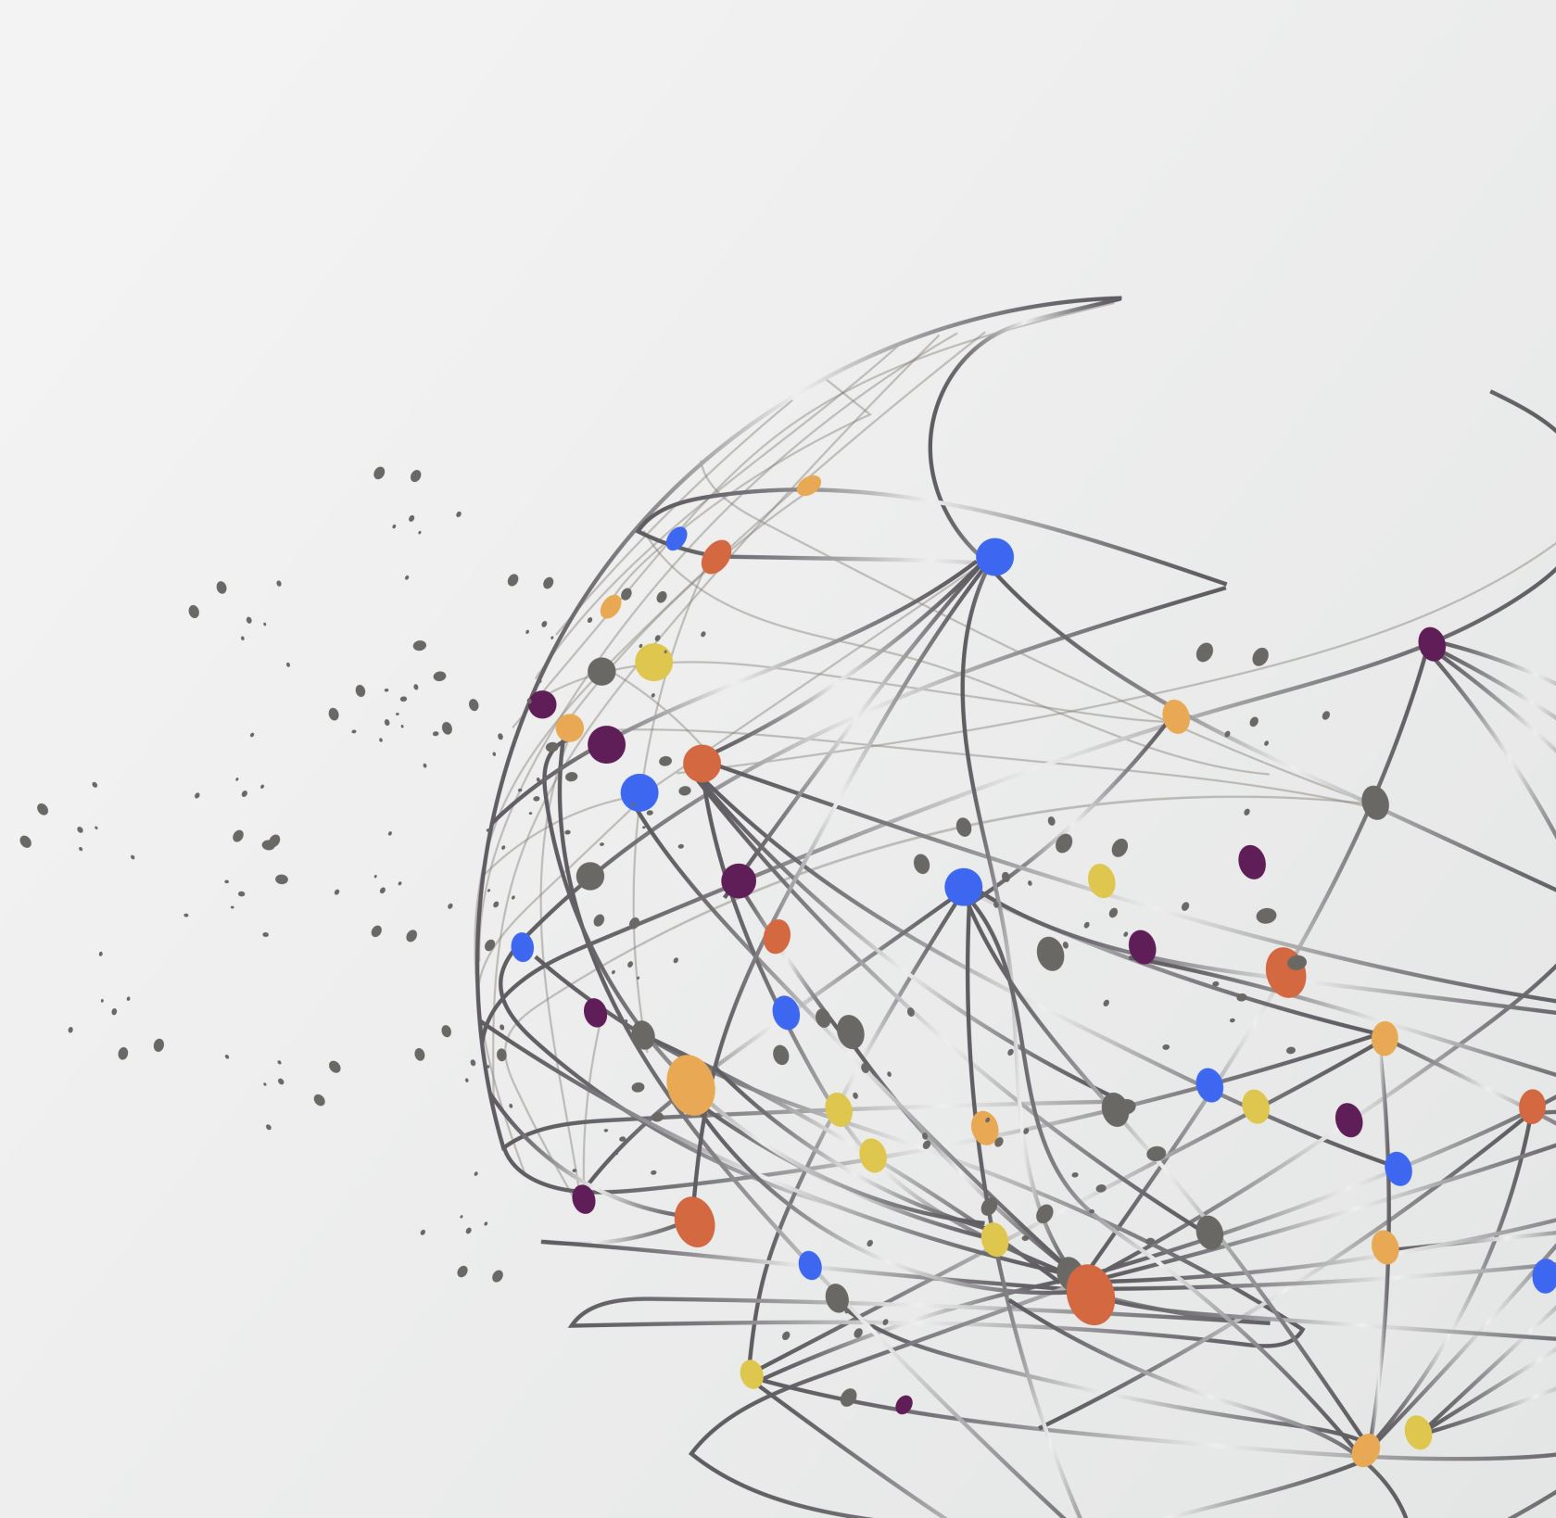
PAthoSpotter: Research network on computational pathology
Prof. Luciano Oliveira
Intelligent Vision Research Lab - UFBA

Slide 2
Disclosure of Relevant Financial Relationships
Dr. Luciano Oliveira declares he has no
conflict(s) of interest to disclose
RDC Nº 96/08 da ANVISA

Slide 3




Research labs
Sponsors
Notes:
On screen, on the left, the main research labs of the PathoSpotter heads. On the right, some of the sponsorships of PathoSpotter.

Slide 4


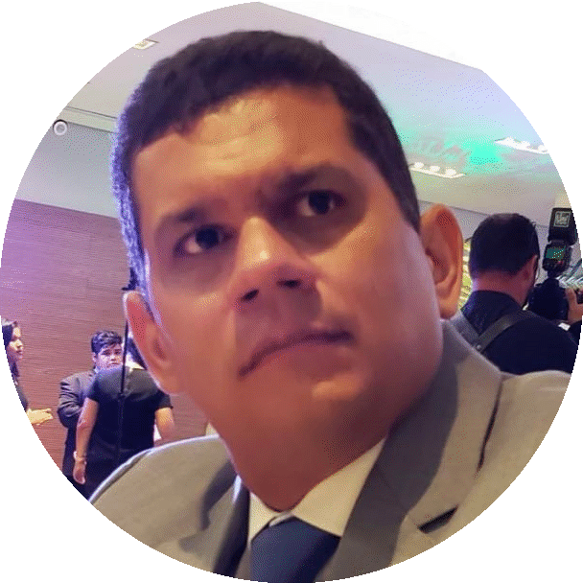






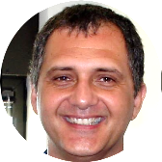
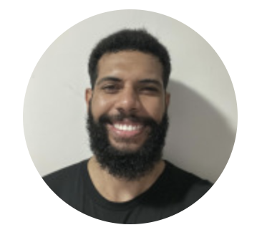


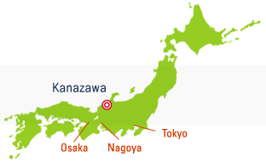
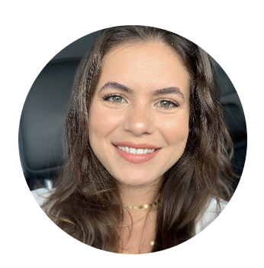






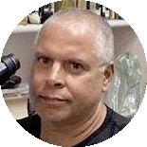





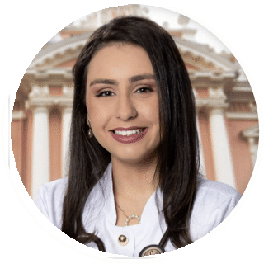
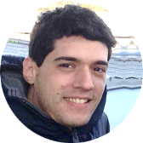
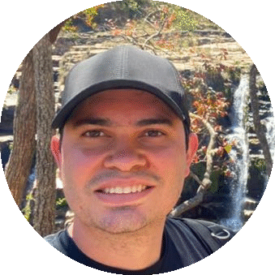
PINAKI SARDER
JUSTINO SANTOS
IGOR PRADO
RODRIGO VERAS
NAYSE ALDMAN
SARAH CERQUEIRA
EMANUELE SANTOS
ELLEN AGUIAR
THIAGO VIEIRA
ANGELO DUARTE
TATIANE CARVALHO
MATHEUS AUGUSTO
MICHELE ANGELO
LUCIANO OLIVEIRA
PÉTALA TUY
LUIZ FREITAS
FLÁVIO VIDAL
PAULO CHAGAS
WASHINGTON DOS-SANTOS
VICTOR NUNES
MATHEUS PIZA
NATHANAEL PINHEIRO
GEORGE BASTOS
MAURO OLIVEIRA
LUIZ OTÁVIO
HENRIQUE PROENÇA
STANLEY ARAÚJO
IZABELLE ROCHA
DAVID WANDERLEY

Slide 5
Timeline: PathoSpotter research
Clinical Journal of the American Society of Nephrology
✅Translating academic research to the clinical practice
Scientific Reports
SPIE Medical Imaging
Computer Methods in Biomechanics and Biomedical Engineering: Imaging & Visualization
✅Classification: hypercellularity
✅Traditional methods
✅Glomerulus detection
✅Traditional methods
✅Tratamento de incerteza do classificador
Computer Methods in Biomechanics and Biomedical Engineering: Imaging & Visualization
✅Transfer learning of image segmenters: from mice to human
2017
2020
2021
2021
2022
2022
2023
Computerized Medical Imaging and Graphics
Artificial Intelligence in Medicine
SIPAIM
✅Semantic segmentation of glomeruli in a WSI
✅ Classification: hypercellularity
✅Deep Learning
✅Able to say ”I don’t know” to an out-of-bound image
Computational Statistics
✅Ensemble of classifiers to classify sclerosis
Notes:
PathoSpotter starts as a network in 2014. Until 2023, our main concerns was on understanding the potential of Machine Learning methods in the tasks of lesion classifier and glomerulus detection. The idea was to grounding the work not only on the bunch of images that Dr. Washington have been gathering during more than 20 years, but also to comprehend on how to translate all the researches to the clinical practice.

Slide 6
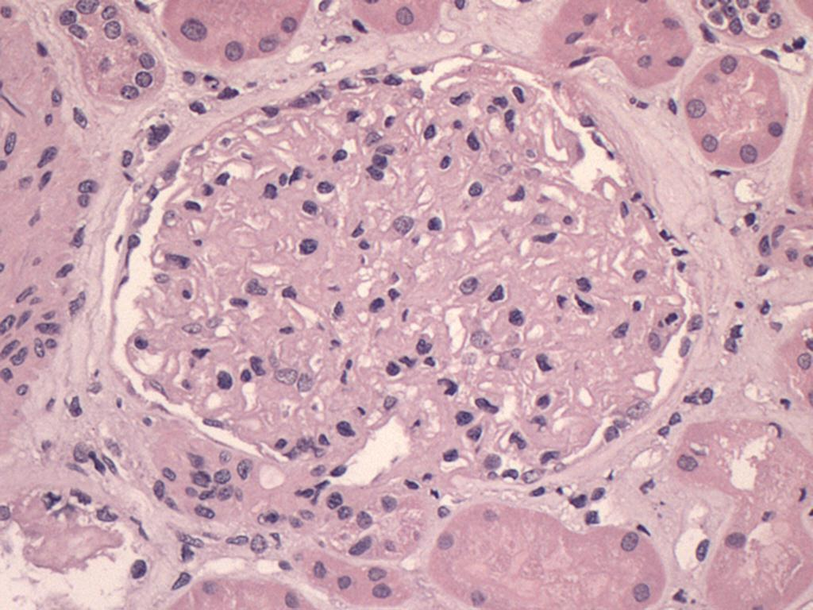
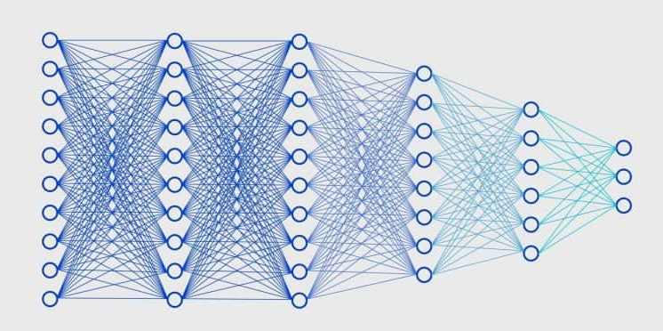
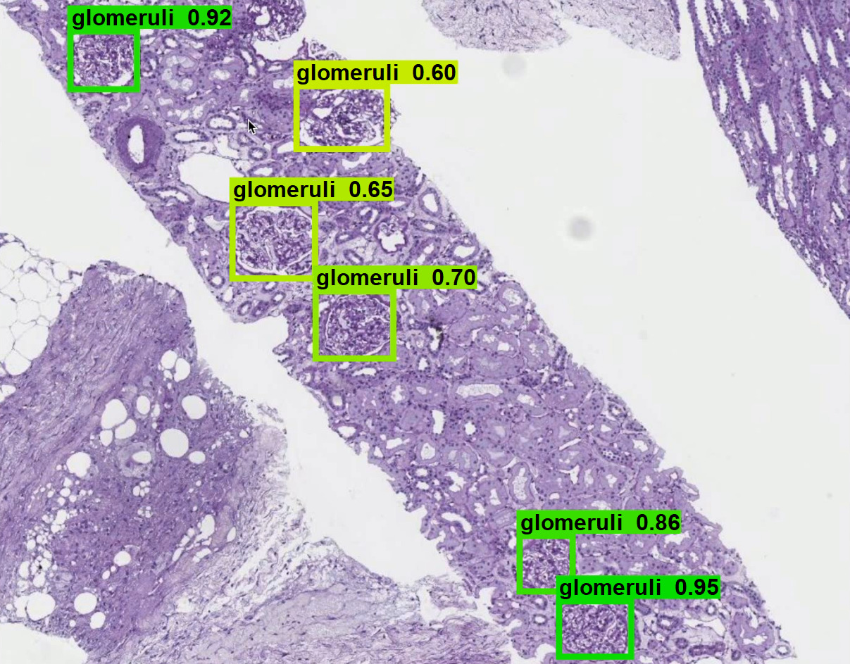
PathoSpotter: First research stage
Between 2014 and 2023: lesion classification and glomerulus detection
Lesion classification:
    Hypercellularity (Mesangial e Endocapillary), Segmentar glomerulosclerosis, Tubulointerstitial (Japan) and Crescent (MEST-C), Membranous
  Open-set classification
  Classifier uncertainty
Glomerulos detection in WSI
Membranous
Non-membranous
Notes:
Patches x whole slide image;

Slide 7
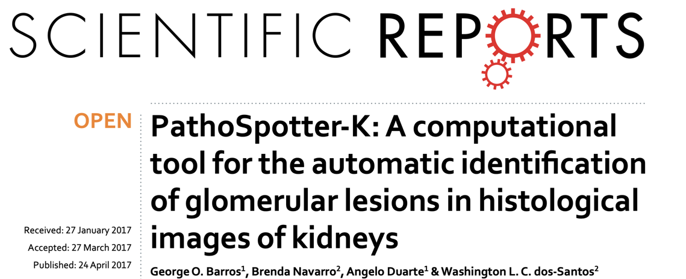
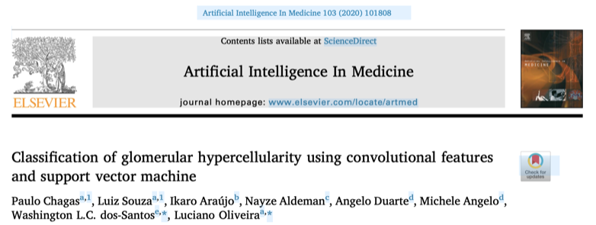
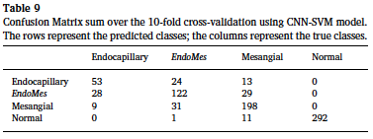
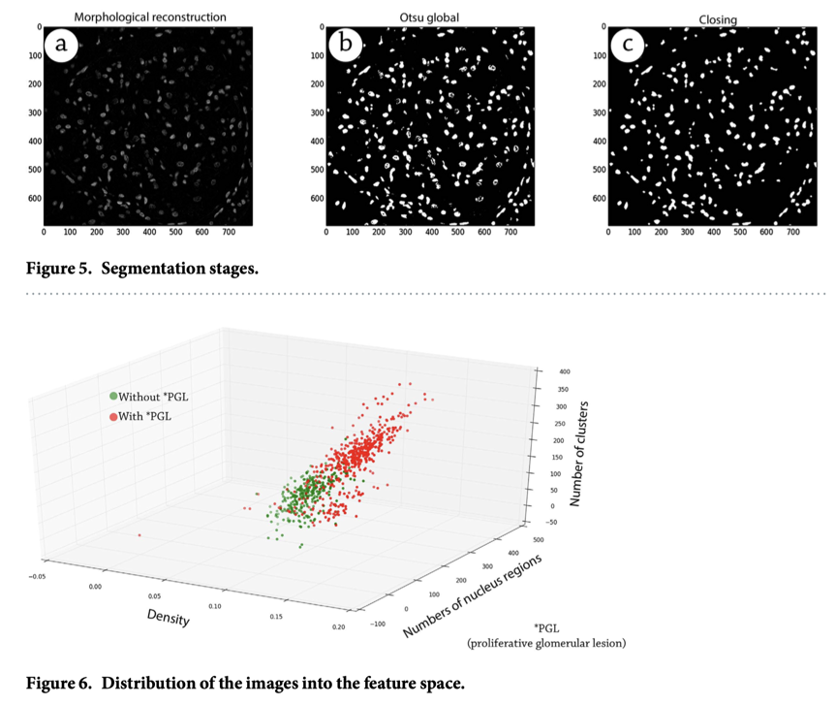
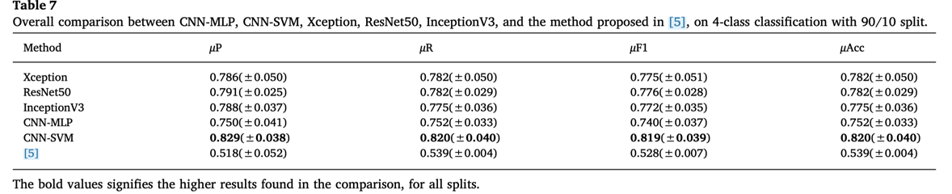
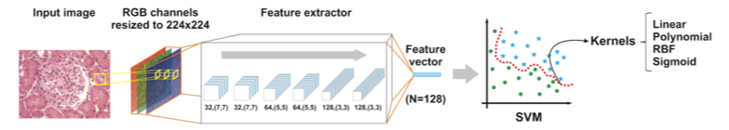
ML traditional
method
Deep
learning
85% of accuracy to distinguish images with or without hypercellularity

Slide 8
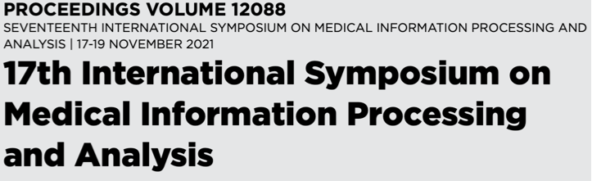
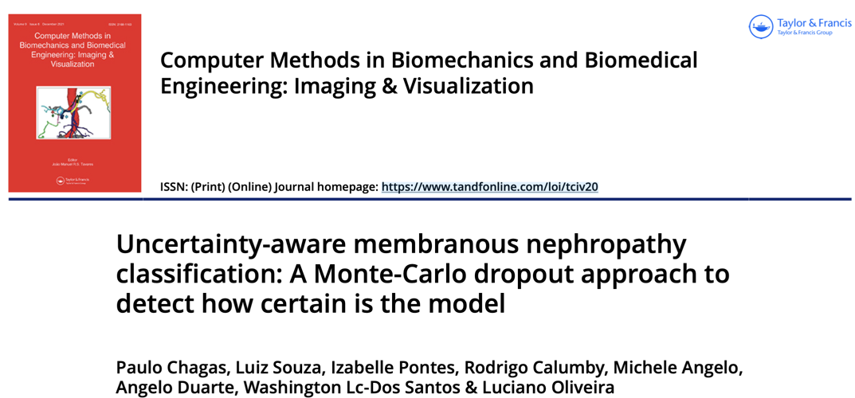
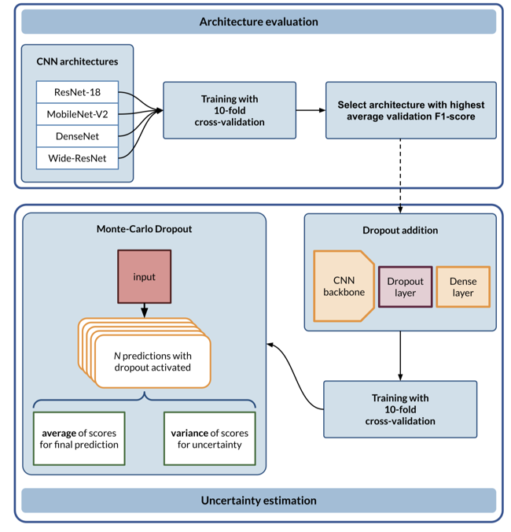

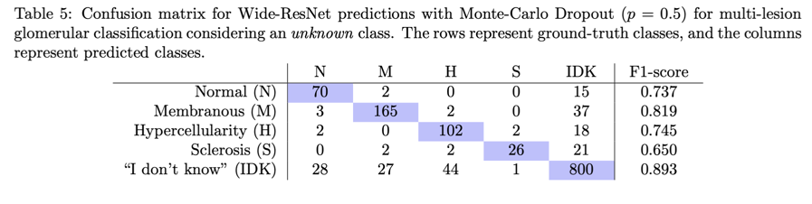
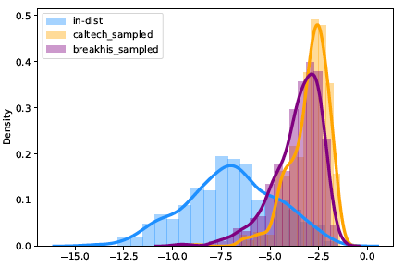
How to provide a dependable degree of classification uncertainty?
Normal
Membranous
Hypercelullarity
Sclerosis
“I don’t know”
Notes:
Classifiers work on the basis of uncertainty, so we have to guarantee that this uncertainty be reliable. For that, we created a

Slide 9


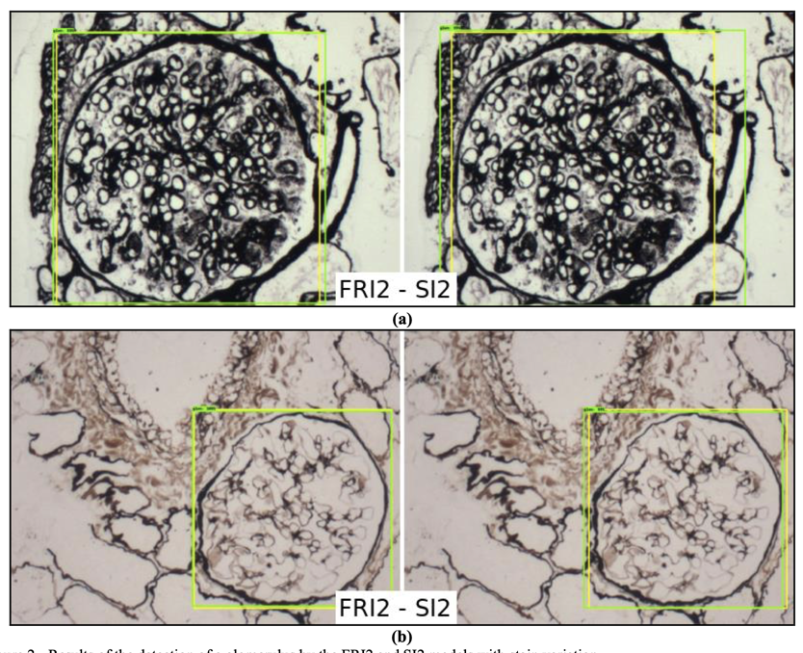

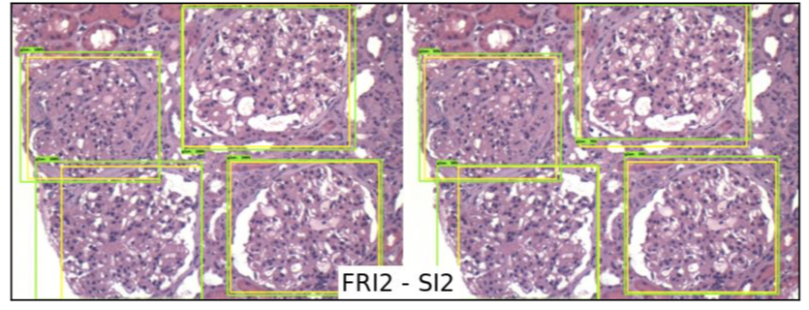
909 images of glomeruli
Pre-trained model + 80/10 train/test
Not a full WSI (HE and PAS)

Slide 10
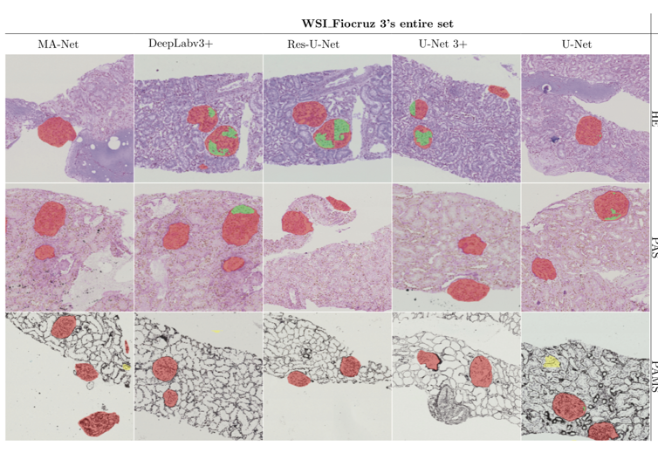
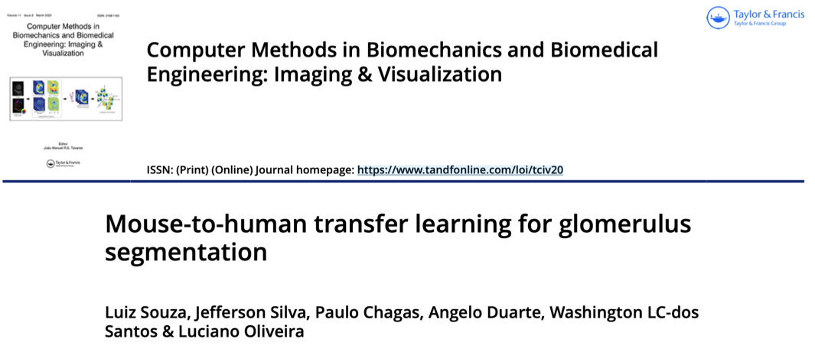
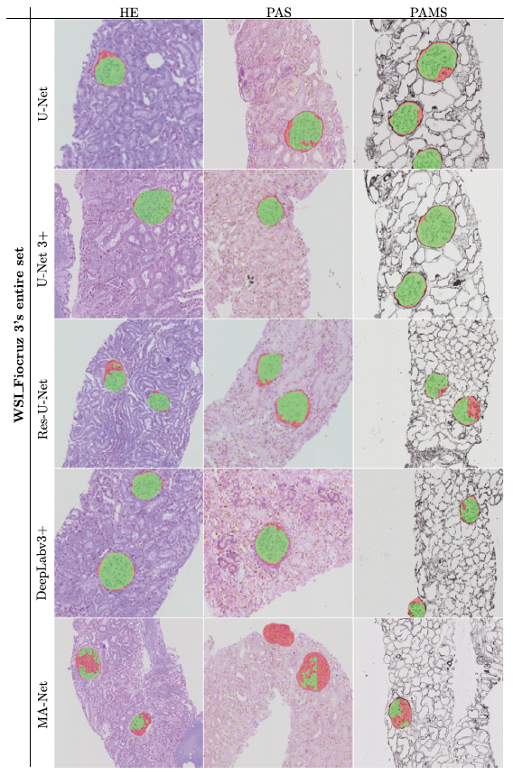
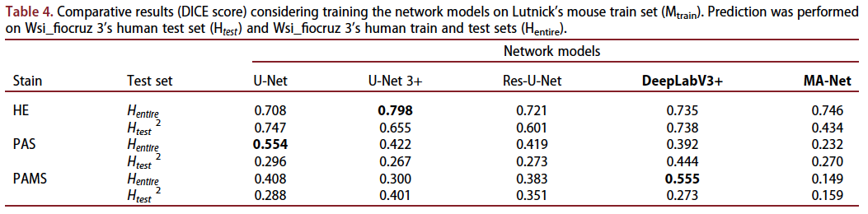
- Disjoint train and test datasets
- Pre-trained model with transfer
learning
- Full WSI (HE, PAS and PAMS)

Slide 11
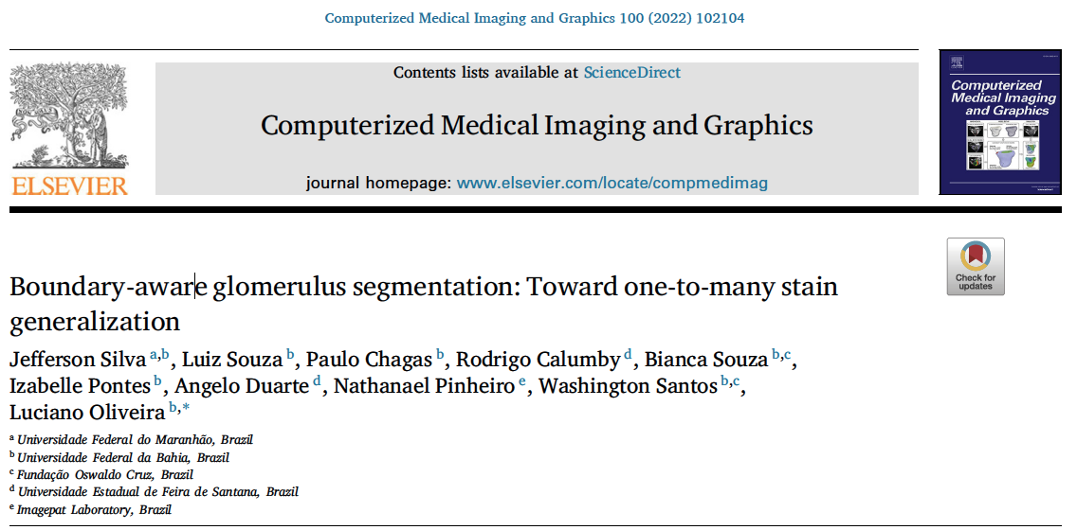
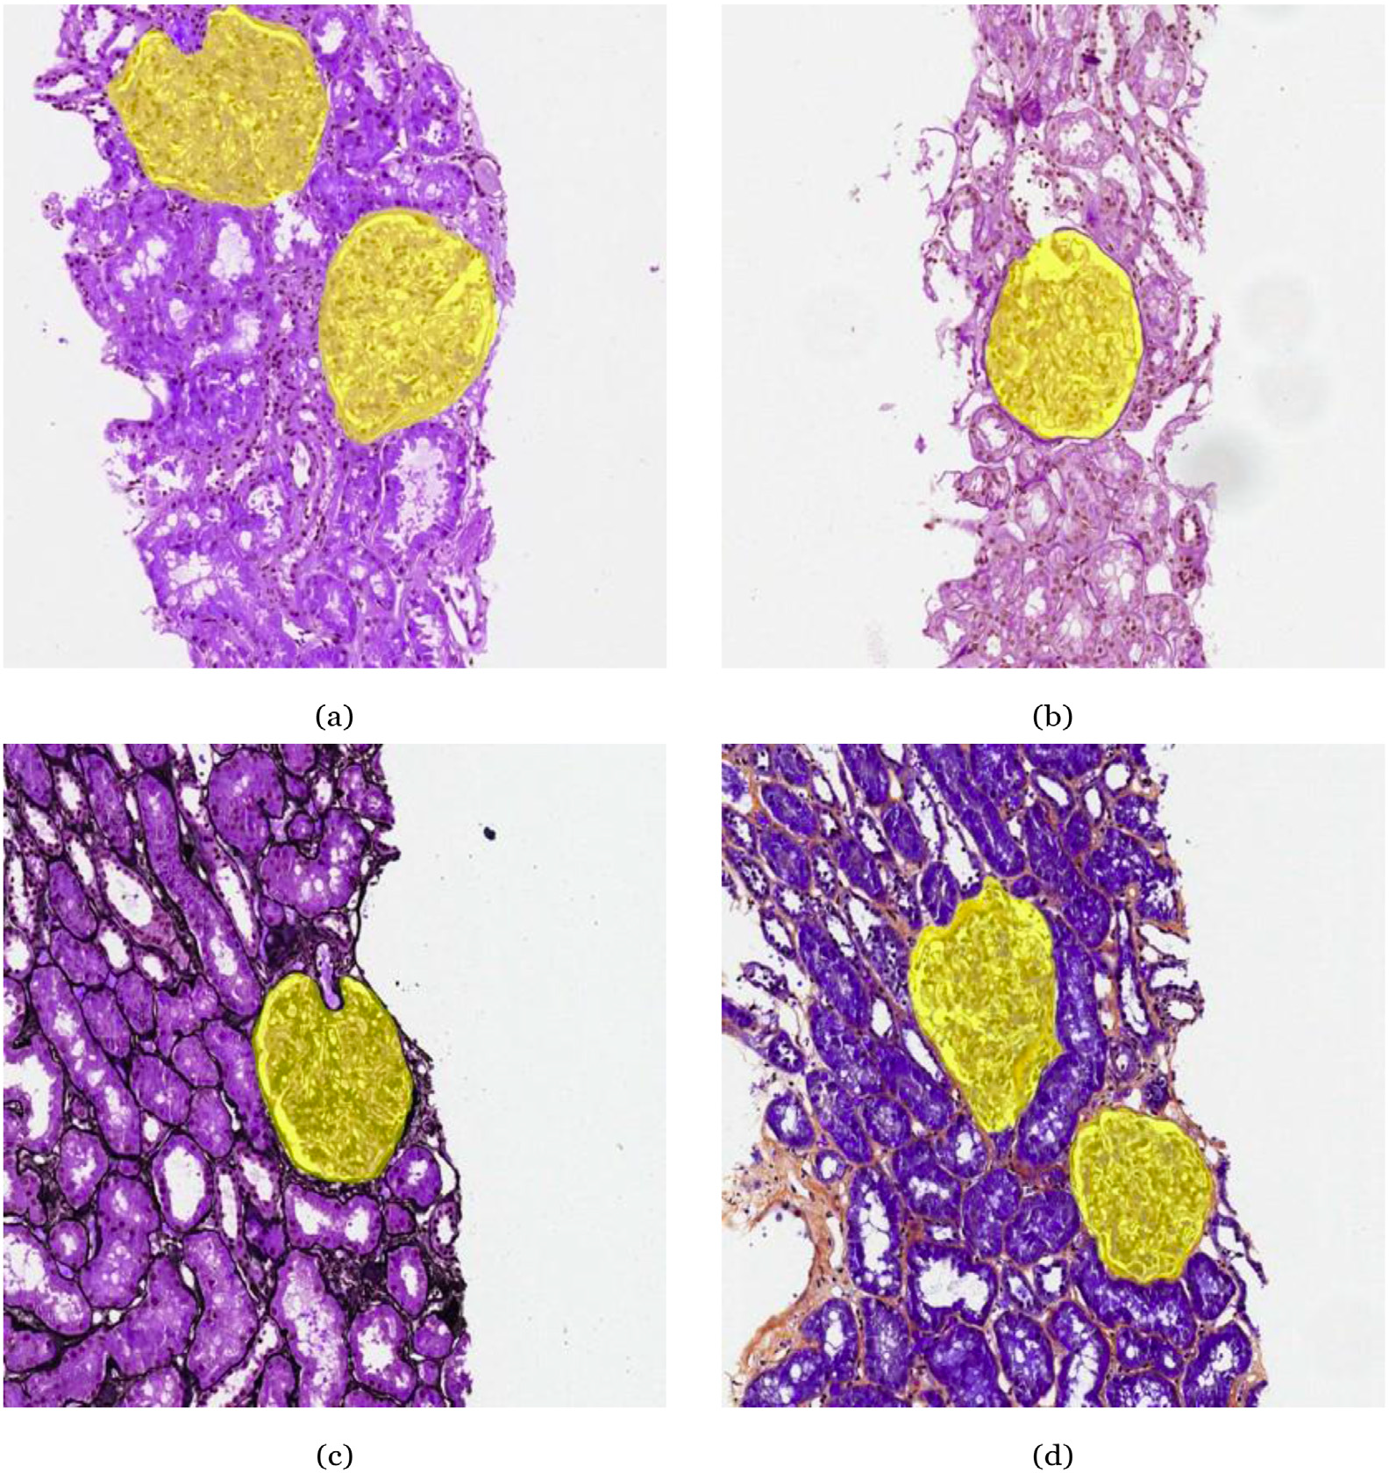
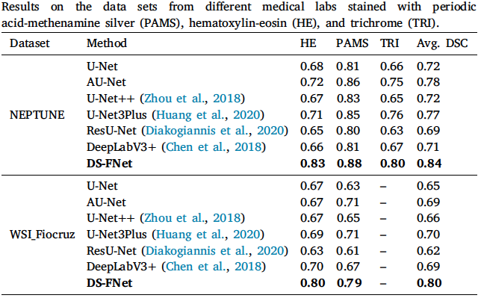
An own model called DS-FNet
Evaluation across three different datasets
More than 5000 glomeruli
Segmentation of glomeruli on biopsy slides
Training with images in HE, only
Generalization to color images in PAS and PAMS
Evaluation on slides from different laboratories

Slide 12
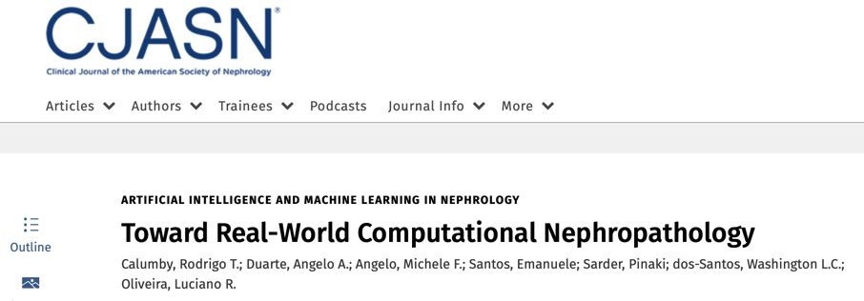
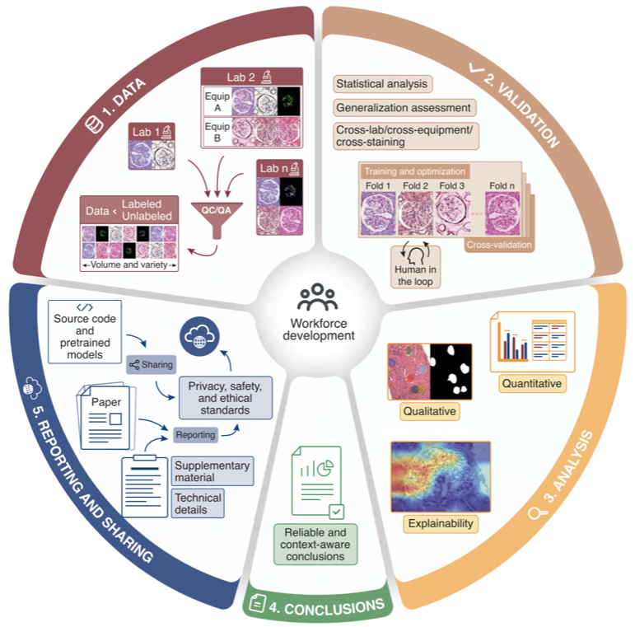
Key words with the past research: data quality control, generalizable models, and proper validation
How to translate academic researches in the realm of computational pathology to the clinical practice?
Is it possible to easily reproduce studies from scientific articles in the field?
Notes:
All the previous researches gave us the experience and maturity to propose a new pathway for the computational pathology research considering translating the works to the clinical practice.

Slide 13
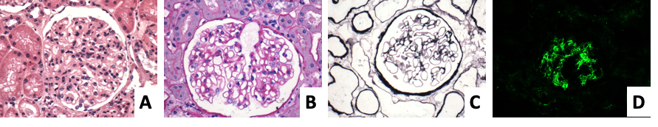
PathoSpotter: Next stage
Image retrieval problem: Semantic search in databases from a query image (in cooperation with Kanazawa University and Hospital)
Matching by means of a learnt metric (instead of hard distances), considering attention and context between the pair of images
Notes:
fluorescência

Slide 14
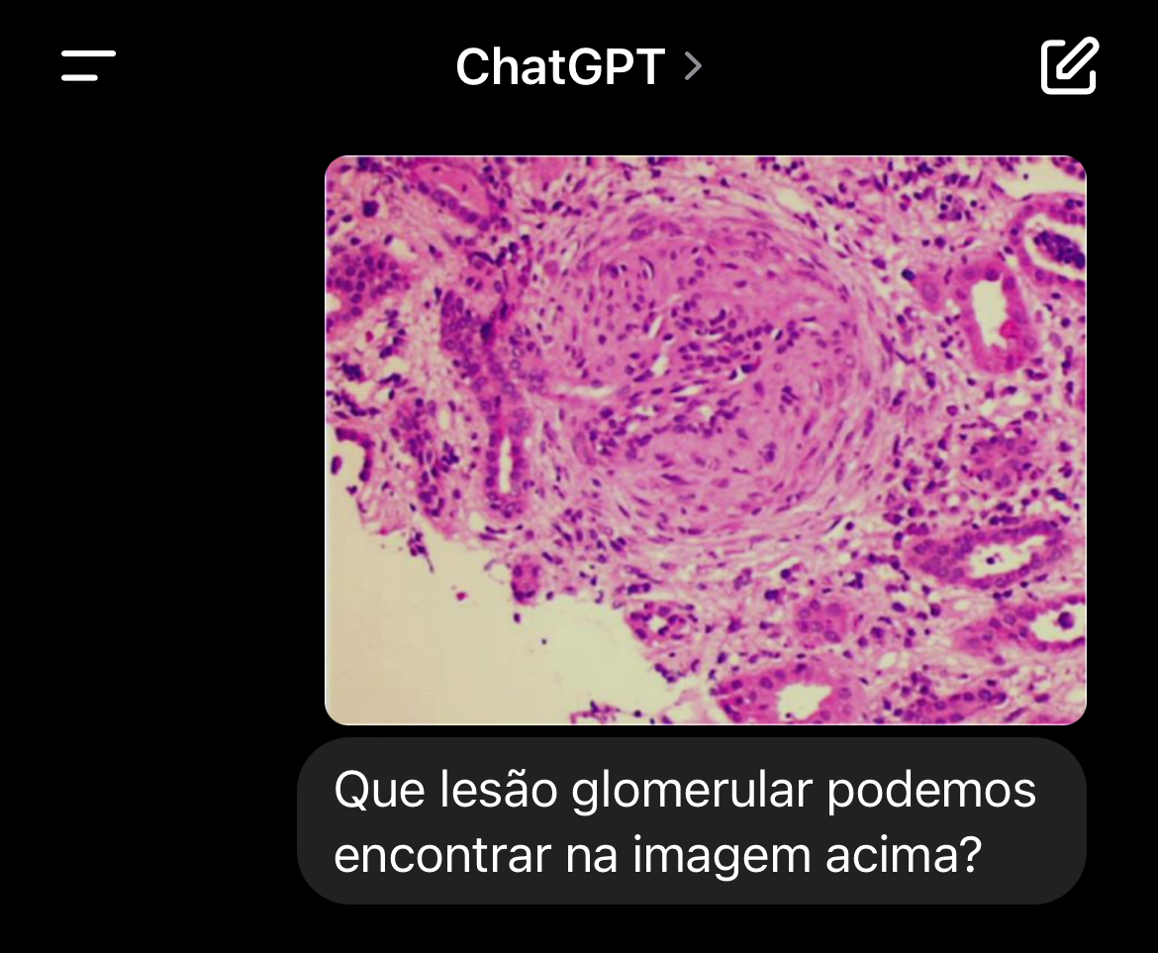
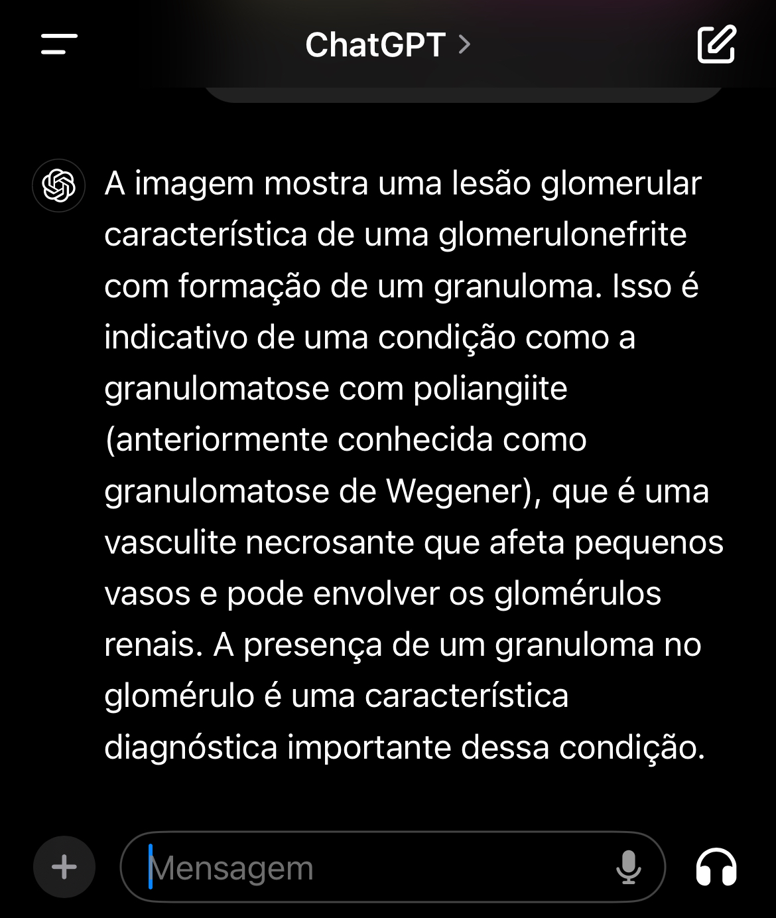
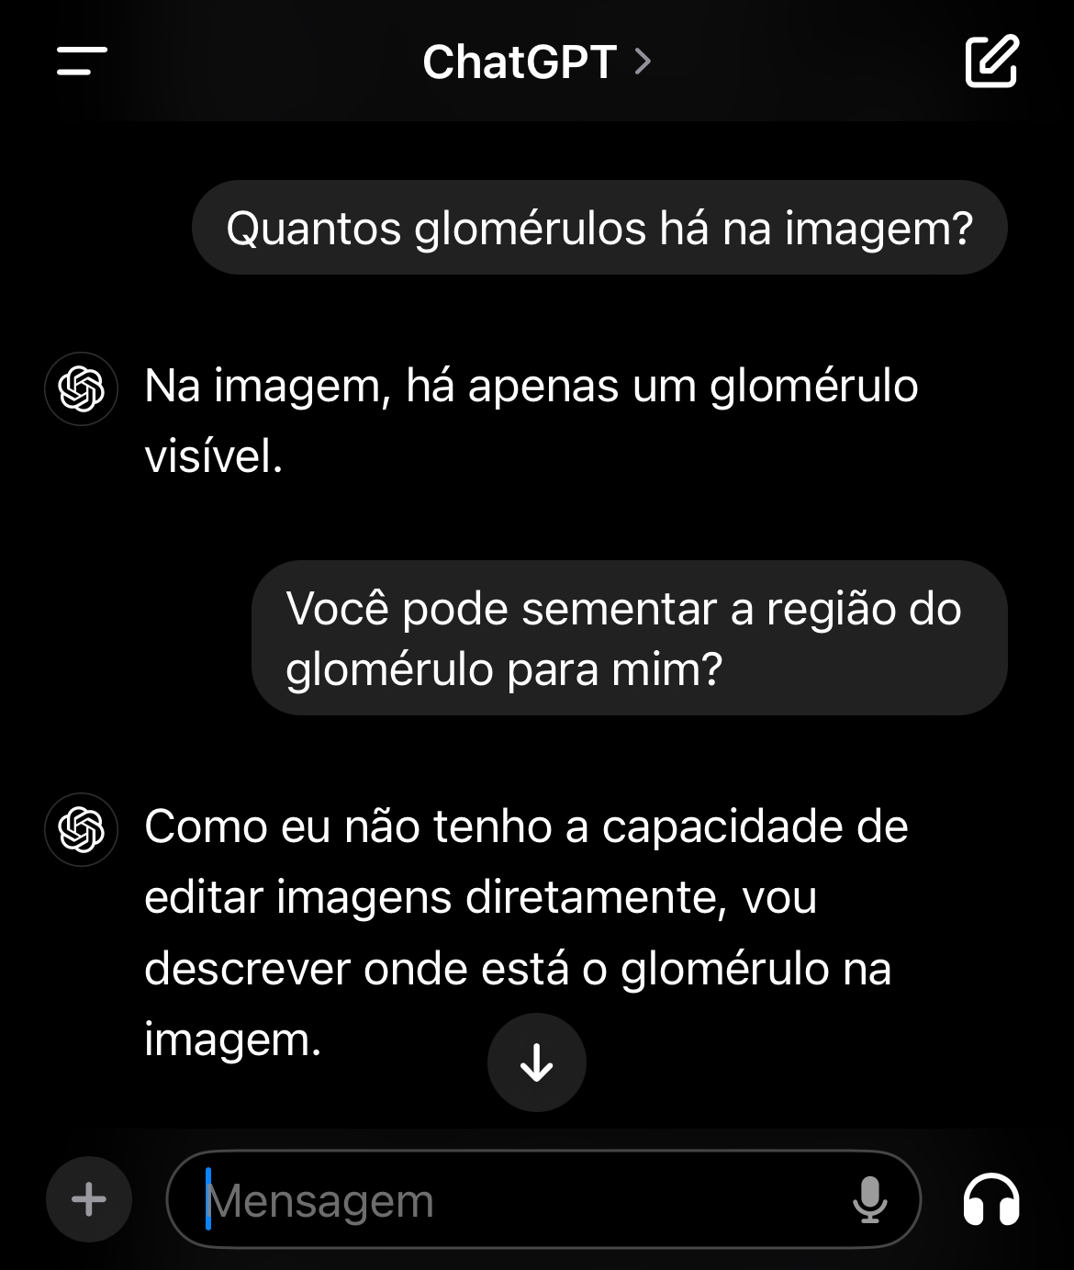
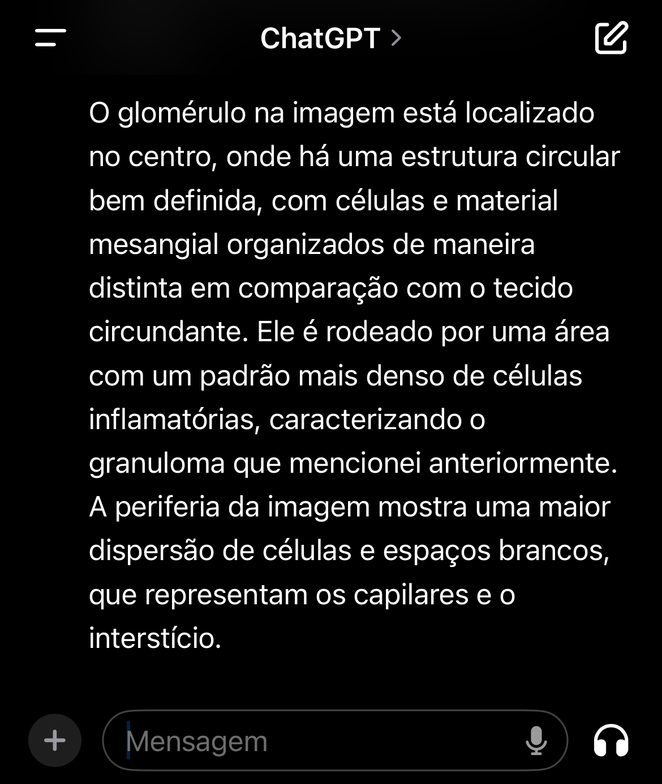
PathoSpotter: Next stage
Visual Question Answering (VQA): Use of LLMs with answers over images
Notes:
This is something that we have already start researching, which is vision language model (join of computer vision and large language model)

Slide 15

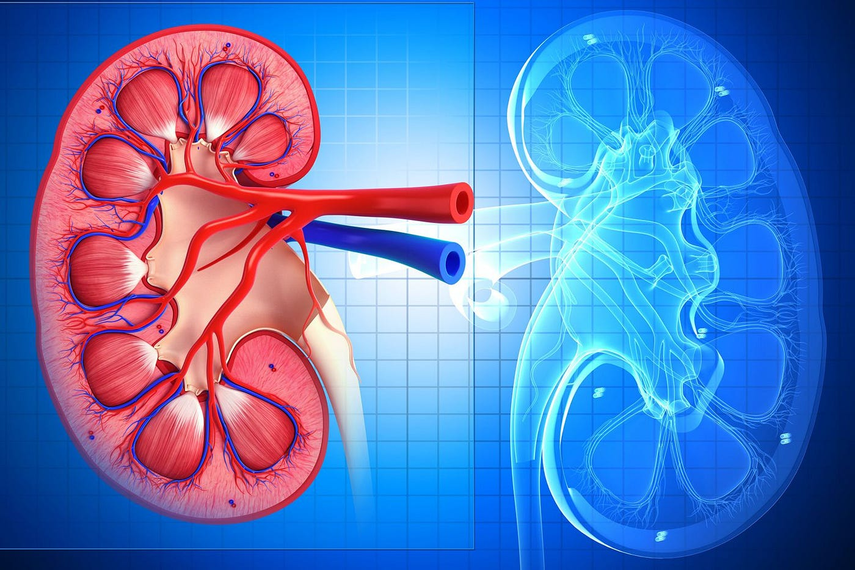
PathoSpotter: Next stage
Disease activity and chronicity
  Along with VQA, we should able our system to provide activity and chronicity of kidney diseases (clinical data + images)
  Pathology Virtual Assistant (PVA)
Notes:
What do all this next topics for? Our main goals is to reach activity and chronicity of kidney diseases. And for that, we will need clinical and image data. The main achievement is to build a pathology virtual assistant.

Slide 16

Thanks!
lrebouca@ufba.br
@ivisionlab
http://ivisionlab.ufba.br
https://pathospotter.uefs.br/

